Slide 1

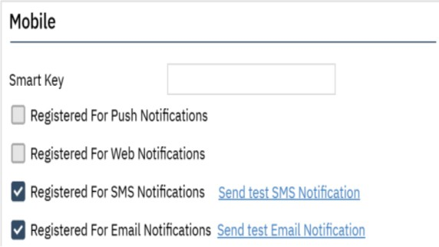
SmartCare Multi-Factor Authentication Relaunch
Multi-factor authentication (MFA) will be relaunched Tuesday 12/17/2024
MFA is used to ensure the best possible security of client data. This means that after entering user ID and password, users will receive an email with a one-time code that will need to be entered before gaining access into the system. Use of MFA will be required every 24 hours to access SmartCare. The change will not impact users who login via Akamai with a San Diego County email address.
Relaunch Reminders
Email:
Email is the default method to receive the MFA code needed for access for the
relaunch. Please ensure the correct email is entered in SmartCare contact section on the
"My Preferences" screen.
For those who use multiple email accounts, a primary email address must be selected for
SmartCare use.
If an email notification is not received, please check spam/junk folder.
Text/SMS Notification - After MFA relaunch:
With the relaunch of MFA, all SMS notification settings, including phone numbers for
text purposes, will be cleared.
After the relaunch of MFA, if text by SMS notification is desired, this can be selected in "My Preferences“, shown on the right.
If setting up text notifications, confirm the identified phone number is not a landline. To use
the SMS function, there MUST be a valid mobile number.
If "My Preferences" for notifications indicate both SMS and Email notifications, the system will only send SMS notifications as text, an email will no longer be sent.
If an error is received when using the “Do not have access to device” link, try restarting the current browser, using a different browser, or clearing cache & cookies.
Page 1 of 2
Updated 12/12/2024
For more information, go to OptumSanDiego.com and click on the SmartCare tab
under MHP Provider Documents for the MH SOC; or DMC-ODS for the SUD SOC.

Slide 2
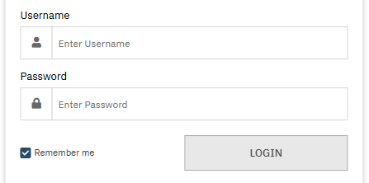
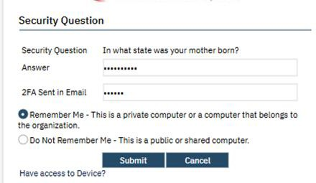
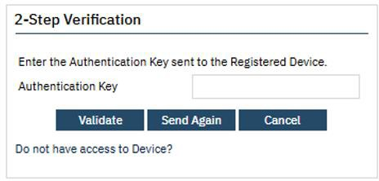
SmartCare Multi-Factor Authentication Relaunch
Instructions for Login After Setting Up MFA
Enter your normal username and password on the first login screen.
If the second authentication method is email, answer the security question and enter the code sent by email.
**Check Spam mailbox, some users have reported the notification goes there.
If the second authentication method is SMS text, enter the code sent by SMS text.
For questions about MFA in SmartCare’s Production environment, contact the CalMHSA helpdesk.
Page 2 of 2
Updated 12/12/2024
For more information, go to OptumSanDiego.com and click on the SmartCare tab
under MHP Provider Documents for the MH SOC; or DMC-ODS for the SUD SOC.

